Slide 1

TENSORFLOW 2.0
PRACTICAL ADVANCED

Slide 2

WHAT’S NEW IN TF 2.0? AND WHY GOOGLE COLAB?

Slide 3
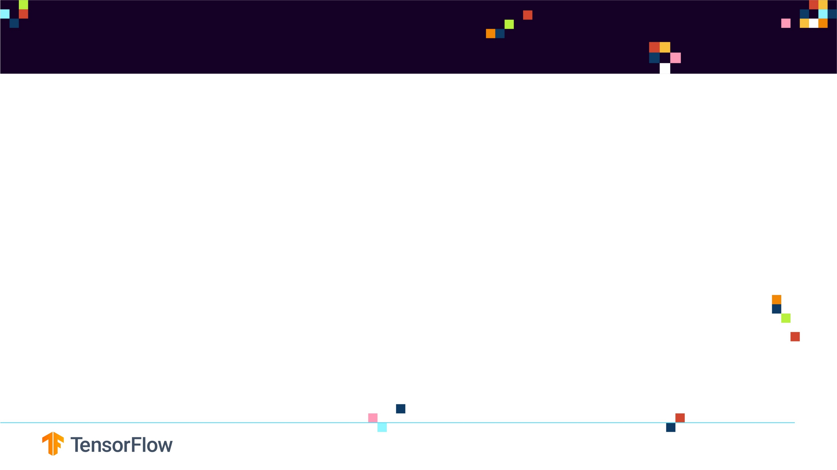
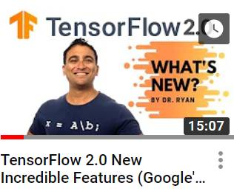
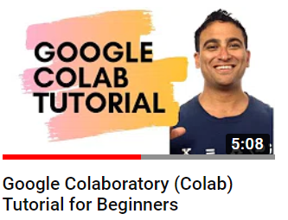
WHAT’S NEW IN TF 2.0? AND WHY USE GOOGLE COLAB?
https://www.youtube.com/watch?v=RsQ45cvhnbM&t=12s
https://www.youtube.com/watch?v=LevQ4efYieU&t=158s

